Slide 1
CREDIT CARD FRAUD DETECTION USING PREDICTIVE MODELLING

Slide 2
Index :
Abstract
Introduction
Problem Statement
Existing system
Disadvantages
Proposed System
Advantages
SRS

Slide 3
Abstract:-
Billions of dollars loss are caused every year due to credit card fraud transaction
To detect these fraud transaction machine learning algorithms gives the efficient way
This project deals why and how under sampling is useful in the presence of class imbalance
how to deal with unbalanced and evolving data streams
how to assess performances in a way which is relevant for detection
how to use feedbacks provided by investigators on the fraud alerts generated

Slide 4
Introduction
Credit cards are used for purchasing goods and services by using virtual card and physical card
In a physical-card based purchase, if the card was stolen then only fraud will be happened
In online payment mode, attackers need only little information for doing fraud
mainly transactions will be done through Internet or telephone
a fraudster simply needs to know the card details.
way to detect this kind of fraud is to analyze the spending patterns on every card
then figure out any inconsistency with respect to the “usual” spending patterns.
Fraud detection based on the analysis of existing purchase data of cardholder is a promising way to reduce the rate of successful credit card frauds

Slide 5
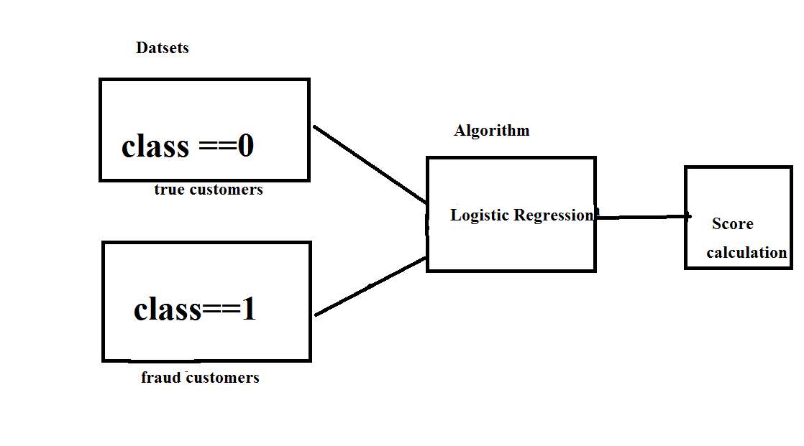
Design:

Slide 6
Problem statement
Credit card fraud stands as major problem for word wide financial institutions.
We can observe this from many financial reports (Bhattacharyya et al., 2011)
10th annual online fraud report by Cyber Source shows that estimated loss due to online fraud is $4 billion for 2008 which is 11% increase than $3.6 billion loss in 2007
In 2006, fraud in United Kingdom alone was estimated to be £535 million in 2007 and now costing around 13.9 billion a year (Mahdi et al., 2010).
From 2006 to 2008, UK alone has lost £427.0 million to £609.90 million due to credit and debit card fraud (Woolsey &Schulz, 2011).
card-not-present fraud losses are increasing at higher rate due to online transactions.
perpetrators are evolving their methods and practices to avoid detection.
Thus an effective and innovative methods need to be develop which will evolve accordingly to the need.

Slide 7
Existing system
This was on k-means Algorithm implementation
The model was set to have 2 clusters, 0 being non-fraud and 1 being fraud.
We also experimented with different values for the hyper parameters
they all produced similar results. Changing the dimensionality of the data

Slide 8
Disadvantages :
The Clustering produce the less accuracy when compared to Regression methods
Comparatively with other algorithms k-means produce less accurate scores

Slide 9
Proposed System:
dataset is gathered from Kaggle.
After initial data exploration, we knew we would implement a logistic regression model for best accuracy reports.
Logistic regression, as it was a good candidate for binary classification.
Python sklearn library was used to implement the project
pandas to data frame for class ==0 for no fraud and class==1 for fraud
matplotlib for plotting the fraud and non fraud data
train_test_split for data extraction (Split arrays or matrices into random train and test subsets)
Using Logistic Regression machine learning algorithm for fraud detection
Finally Confusion matrix was plotted on true and predicted.

Slide 10
Advantages:
The results obtained by the Logistic Regression Algorithm is best
The Accuracy obtained was almost equal to cent percent
It gives the plots after processing the data

Slide 11
Hardware Requirements:
• RAM: 4GB and Higher
• Processor: Intel i3 and above
• Hard Disk: 500GB: Minimum

Slide 12
Software Requirements:
OS: Windows or Linux
Python IDE : python 2.7.x and above
Pycharm IDE Required
Setup tools and pip to be installed for 3.6 and above
Language : Python Scripting

Slide 13
modules

Slide 14
Pandas
Pandas is an open-source, Python library providing high-performance, easy-to-use data structures and data analysis tools for the Python programming language.
Python with Pandas is used in a wide range of fields including academic and commercial domains including finance, economics, Statistics, analytics, etc.

Slide 15
Numpy
NumPy, which stands for Numerical Python, is a library consisting of multidimensional array objects and a collection of routines for processing those arrays.
Using NumPy, mathematical and logical operations on arrays can be performed.
This tutorial explains the basics of NumPy such as its architecture and environment. It also discusses the various array functions, types of indexing, etc.
introduction to Matplotlib is also provided. All this is explained with the help of examples for better understanding.

Slide 16
Matplotlib
matplotlib is probably the single most used Python package for 2D-graphics. It provides both a very quick way to visualize data from Python and publication-quality figures in many formats. We are going to explore matplotlib in interactive mode covering most common cases.

Slide 17
Sklearn
There are several Python libraries which provide solid implementations of a range of machine learning algorithms. One of the best known is Scikit-Learn, a package that provides efficient versions of a large number of common algorithms. Scikit-Learn is characterized by a clean, uniform, and streamlined API, as well as by very useful and complete online documentation. A benefit of this uniformity is that once you understand the basic use and syntax of Scikit-Learn for one type of model, switching to a new model or algorithm is very straightforward.
This section provides an overview of the Scikit-Learn API; a solid understanding of these API elements will form the foundation for understanding the deeper practical discussion of machine learning algorithms and approaches in the following chapters.
SAFARI
Learn faster. Dig deeper. See farther.
Join Safari. Get a free trial today and find answers on the fly, or master something new and useful.
Learn more
We will start by covering data representation in Scikit-Learn, followed by covering the Estimator API, and finally go through a more interesting example of using these tools for exploring a set of images of hand-written digits.

Slide 18
Architecture

Slide 19
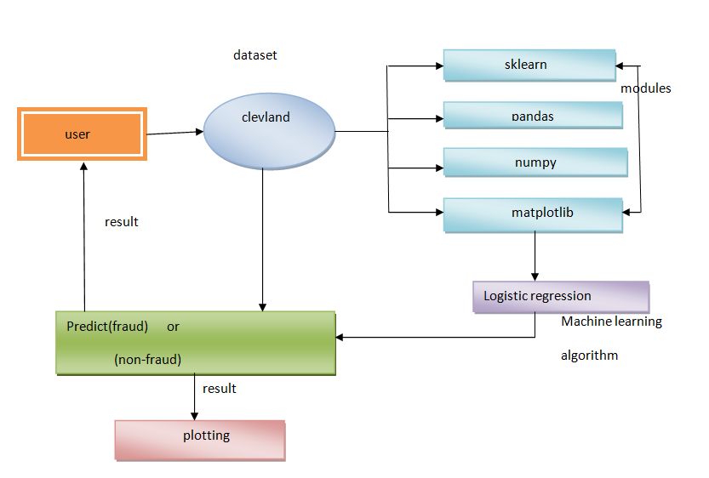

Slide 20
UMLS ON CREDITCARD FRAUD DETECTION

Slide 21
Class diagram:

Slide 22
Activity diagram
Activity diagrams are graphical representations of Workflows of stepwise activities and actions with support for choice, iteration and concurrency. In the Unified Modeling Language, activity diagrams can be used to describe the business and operational step-by-step workflows of components in a system. An activity diagram shows the overall flow of control.

Slide 24
Sequence diagram:
A sequence diagram in Unified Modeling Language (UML) is a kind of interaction diagram that shows how processes operate with one another and in what order. It is a construct of a Message Sequence Chart. A sequence diagram shows, as parallel vertical lines ("lifelines"), different processes or objects that live simultaneously, and, as horizontal arrows, the messages exchanged between them, in the order in which they occur. This allows the specification of simple runtime scenarios in a graphical manner.

Slide 25
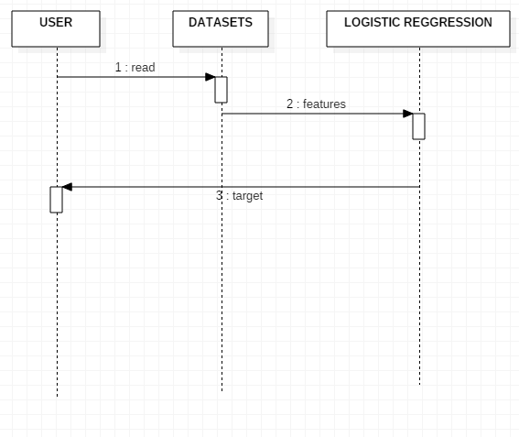

Slide 26
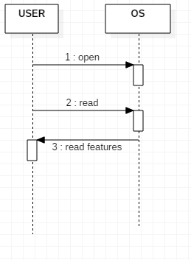

Slide 27
Component diagram

Slide 28
Deployement diagram:

Slide 29
Dataset sreenshots

Slide 30
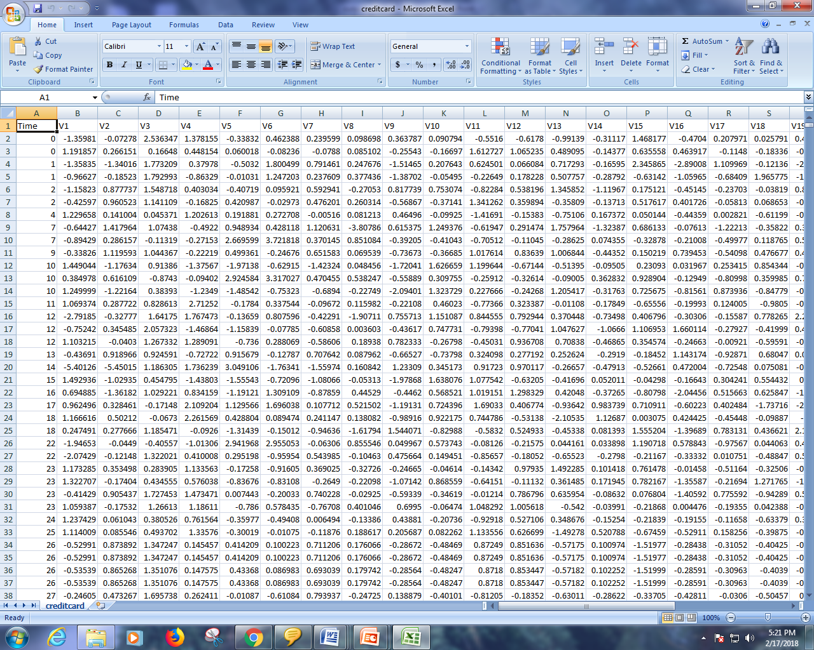

Slide 31
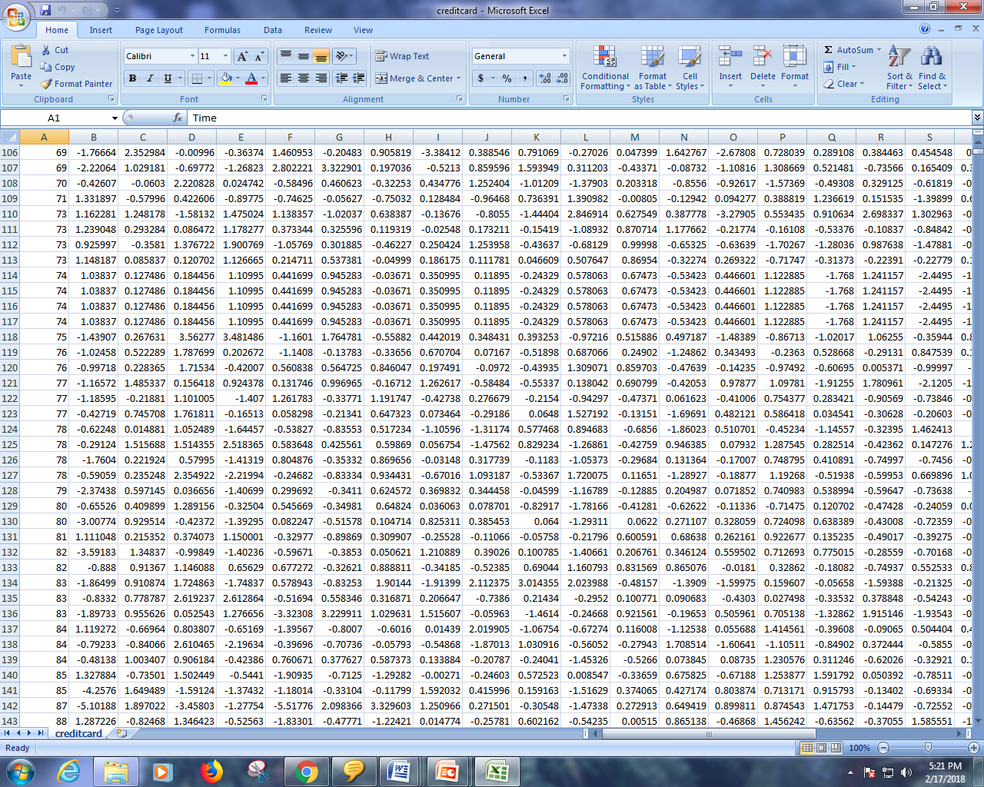

Slide 32
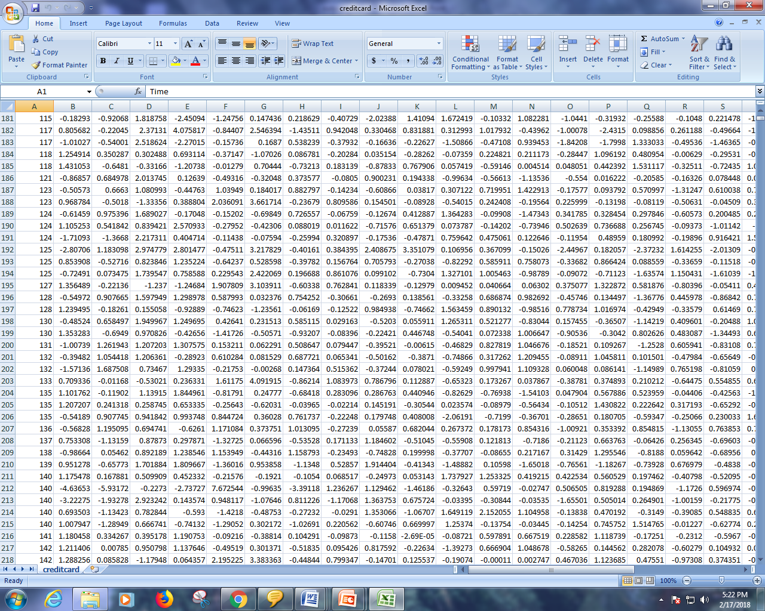

Slide 33
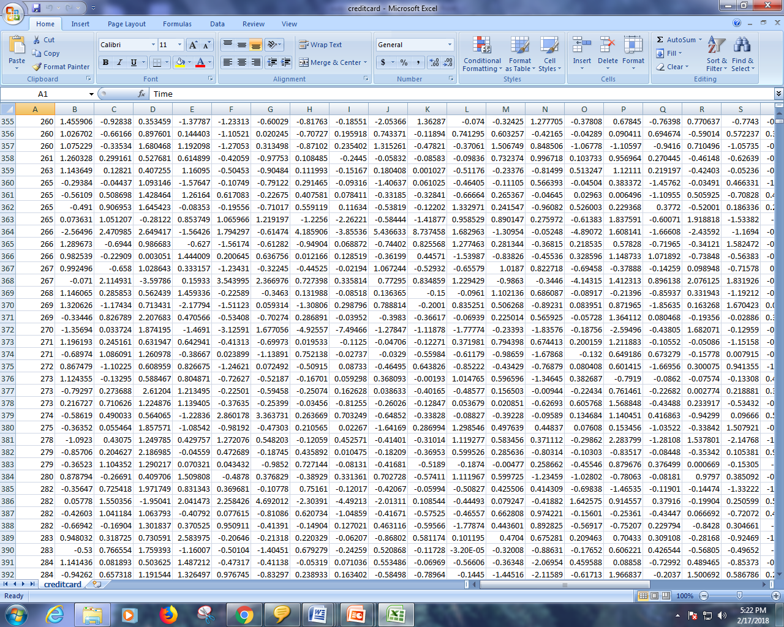

Slide 34
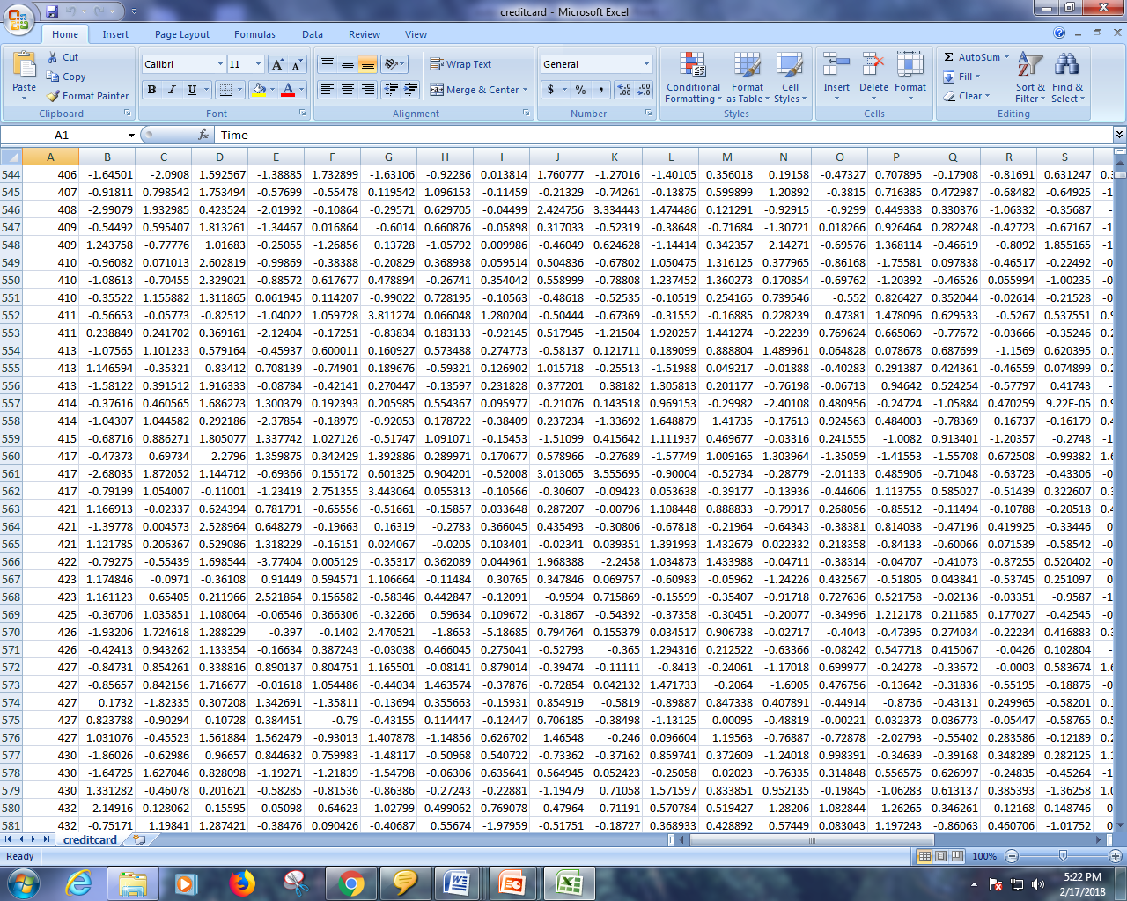

Slide 35
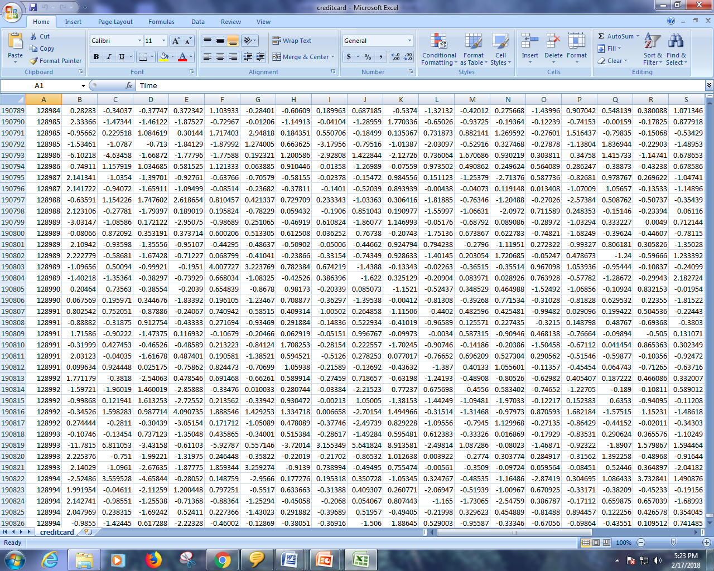

Slide 36
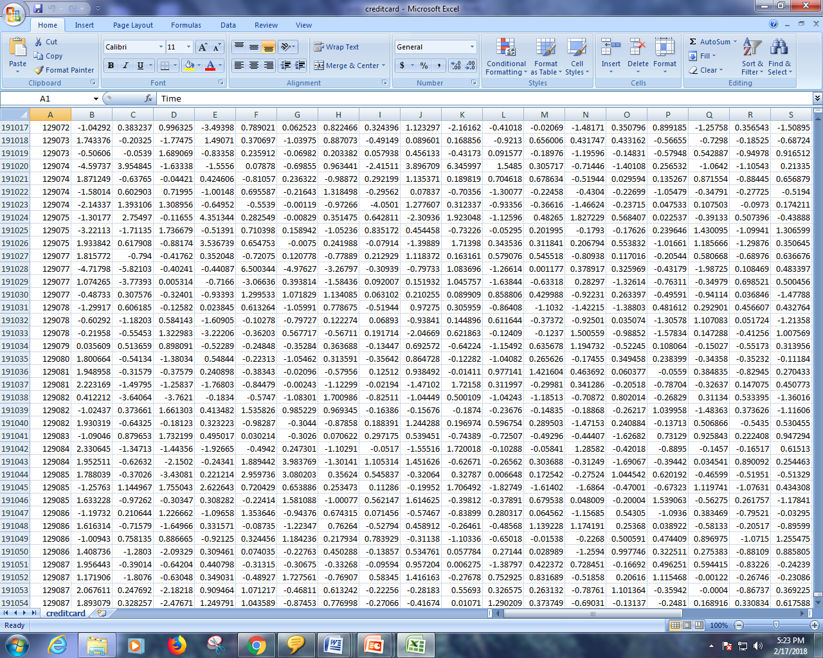

Slide 37
Algorithm

Slide 38
LOGISTIC REGRESSION
Logistic regression is a statistical method for analyzing a dataset in which there are one or more independent variables that determine an outcome. The outcome is measured with a dichotomous variable (in which there are only two possible outcomes).
Logistic regression is one of the most popular machine learning algorithms for binary classification. This is because it is a simple algorithm that performs very well on a wide range of problems.
In this post you are going to discover the logistic regression algorithm for binary classification, step-by-step. After reading this post you will know:
How to calculate the logistic function.
How to learn the coefficients for a logistic regression model using stochastic gradient descent.
How to make predictions using a logistic regression model.

Slide 39
THANK YOU

